Slide 1
CIS 393 Project 2
Presented by Sam Cisney

Slide 2

Overview
The purpose of this project is a blog site with a homepage, login page, and Q&A page to submit questions. The login page allows a user to search a user page with a username or allow a new user page to be created. (this is all connected to the database).
On the profile page you can delete or update a user.

Slide 3
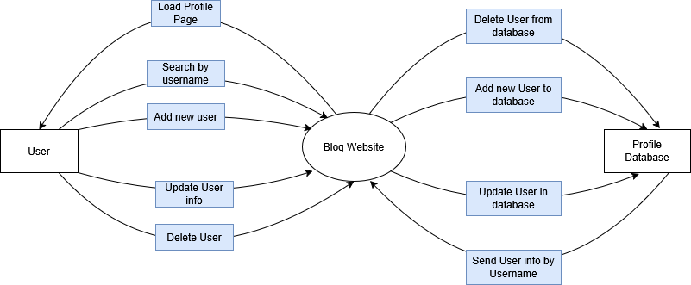
Top level Diagram

